Slide 1
Software Testing
“Testing is the process of executing a program with the intent of finding errors.”
Why it’s imp: Although software testing is itself an expensive activity, yet launching of software without testing may lead to cost potentially much higher than that of testing, specially in systems where human safety is involved.

Slide 2
Why it’s imp
In the software life cycle the earlier the errors are discovered and removed, the lower is the cost of their removal.

Slide 3
Software Testing
Functional Testing / black box :Testing is based on functionality of program.
Based only on observations of the output for certain input values.
Structural Testing /white box: It permits us to examine the internal structure of the program.

Slide 4
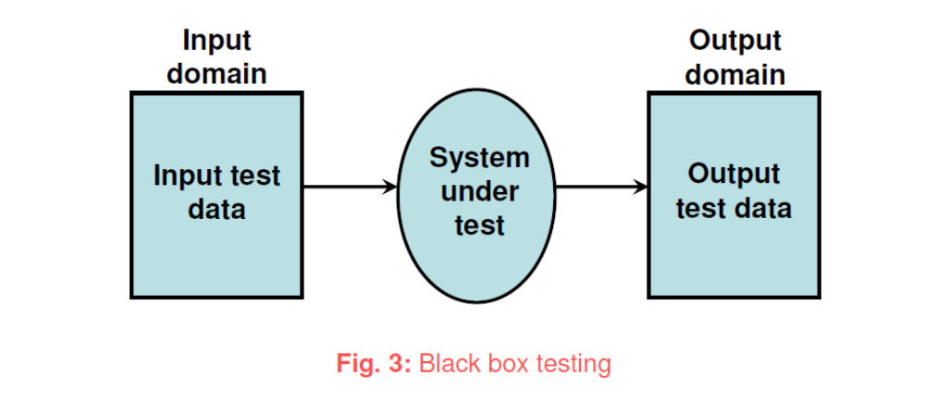
Software Testing
Functional Testing / black box /behavioral

Slide 5
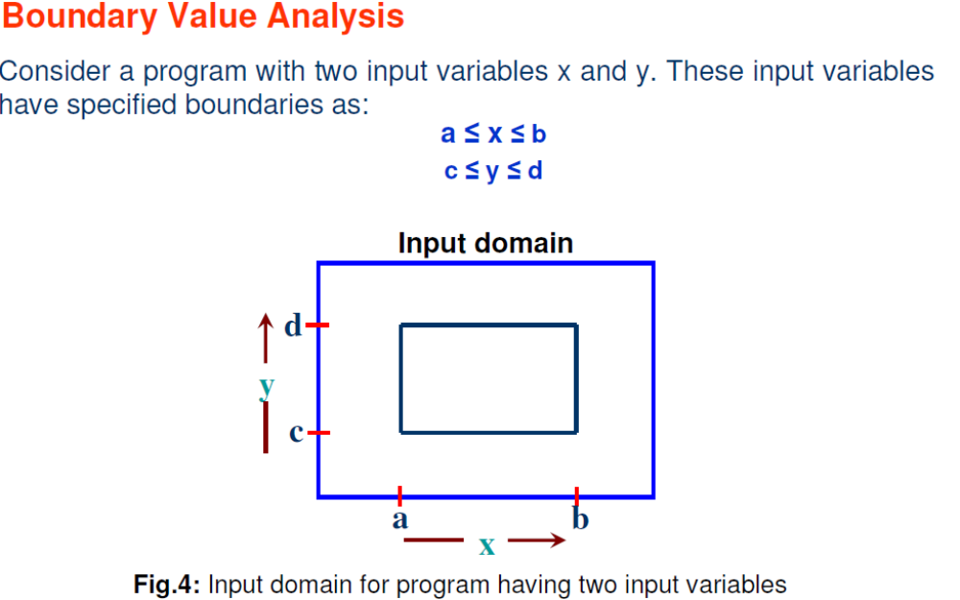
Software Testing
Functional Testing / black box /behavioral

Slide 6
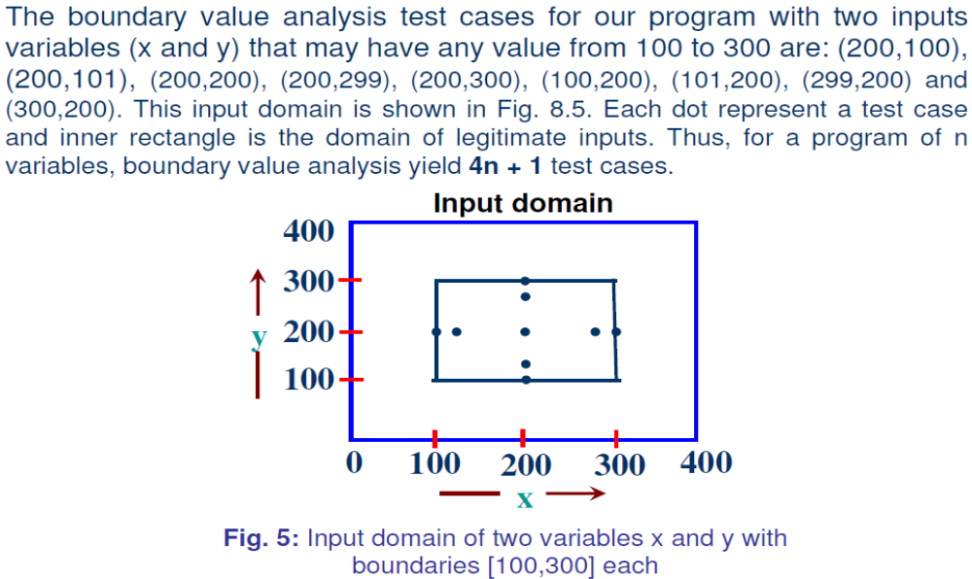
Software Testing
Functional Testing / black box /behavioral

Slide 8
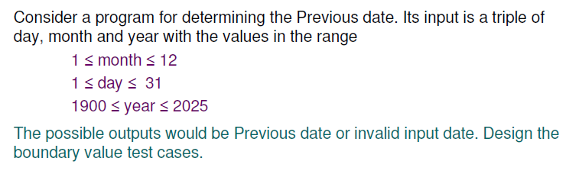

Slide 9
The Previous date program takes a date as input and checks it for validity.
If valid, it returns the previous date as its output.
With single fault assumption theory, 4n+1 test cases can be designed and which are equal to 13.

Slide 10
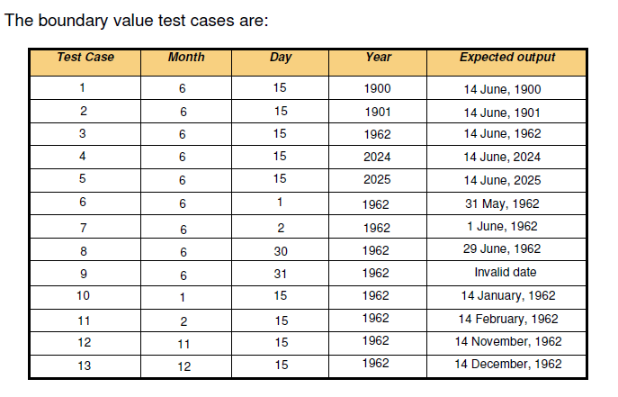

Slide 11
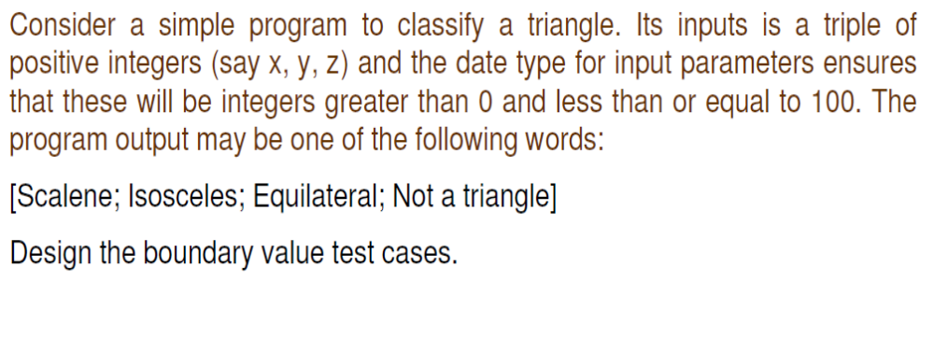
Software Testing
Functional Testing / black box /behavioral

Slide 12
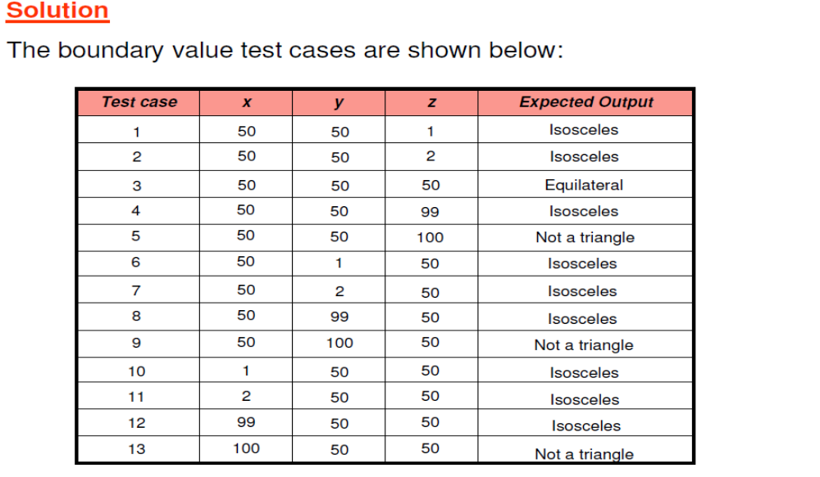
Software Testing
Functional Testing / black box /behavioral

Slide 13
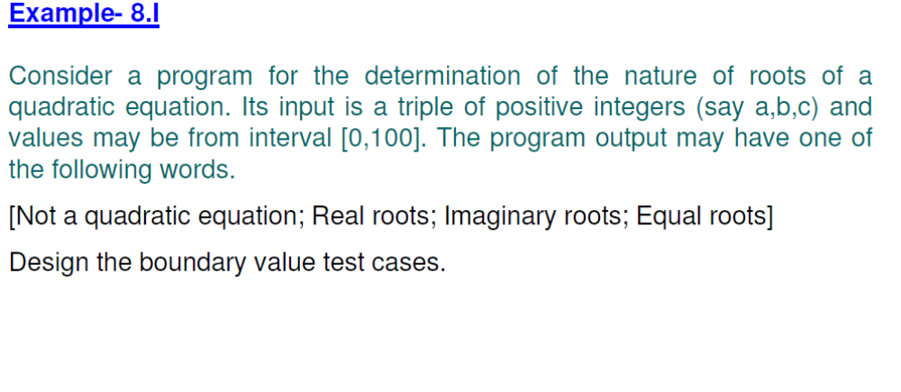
Software Testing
Functional Testing / black box /behavioral

Slide 14
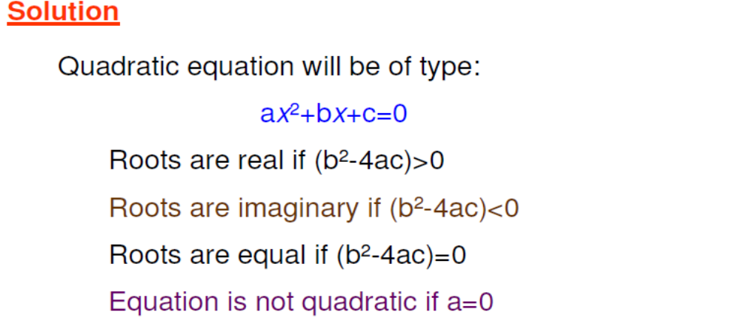
Software Testing
Functional Testing / black box /behavioral

Slide 15
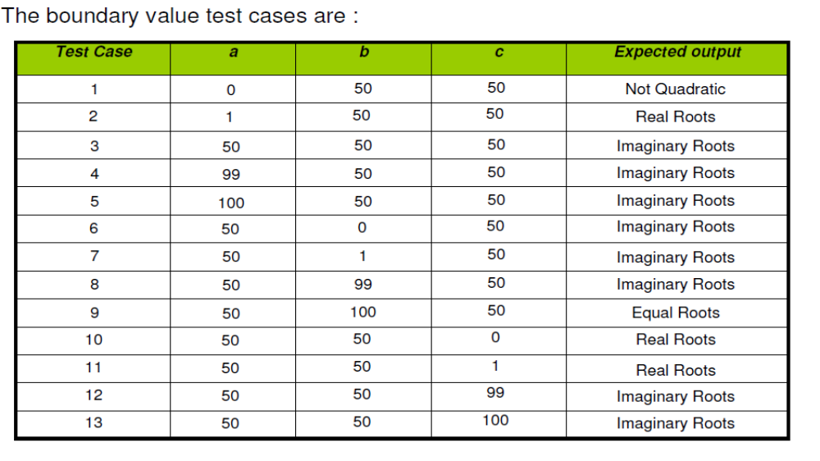
Software Testing
Functional Testing / black box /behavioral

Slide 16
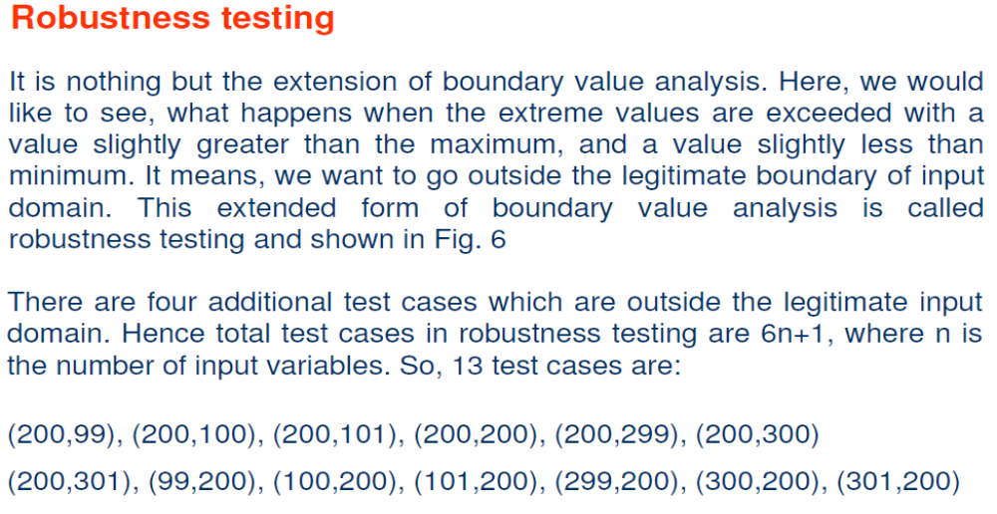
Software Testing
Functional Testing / black box /behavioral

Slide 17
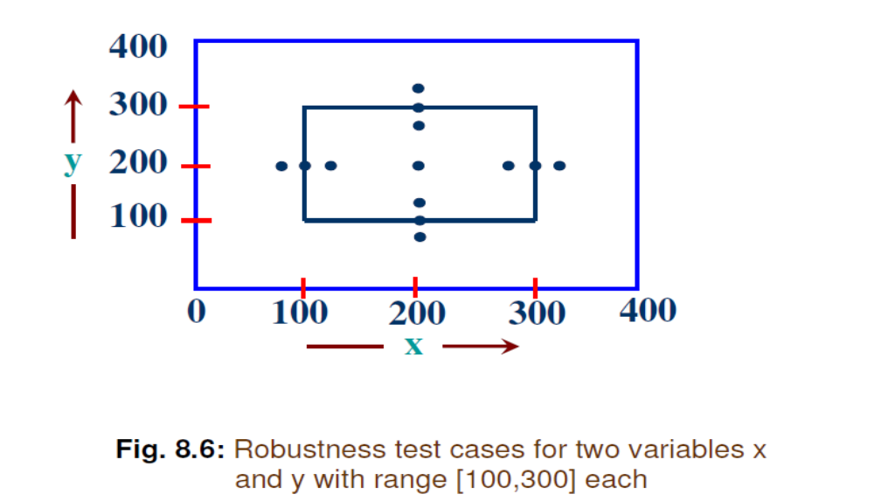
Software Testing
Functional Testing / black box /behavioral

Slide 18
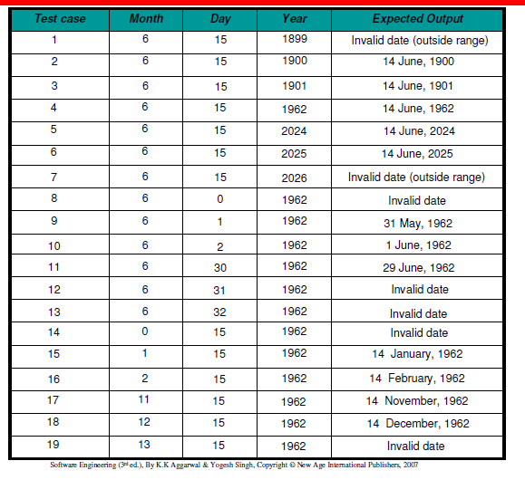
Robustness Testing

Slide 19
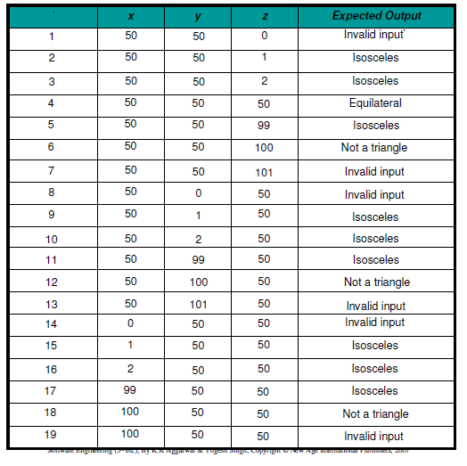
Robustness Testing

Slide 20
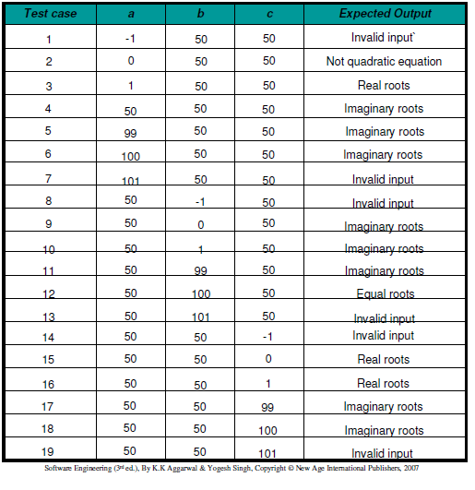
Robustness Testing

Slide 21
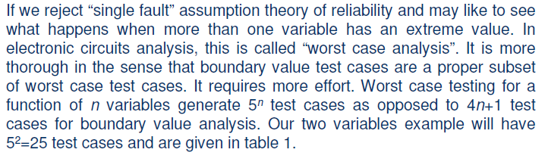
Worst-Case Testing

Slide 22
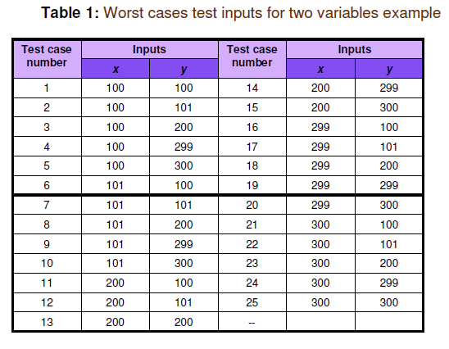
Worst-Case Testing

Slide 23
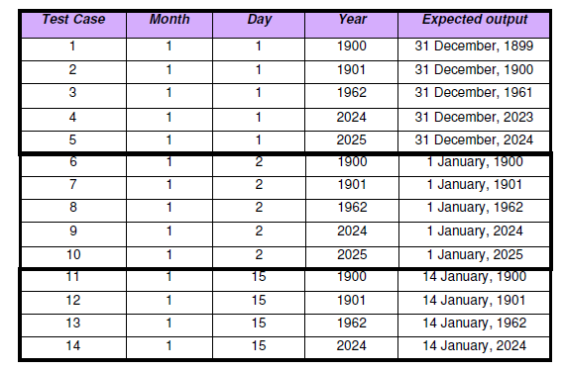

Slide 24
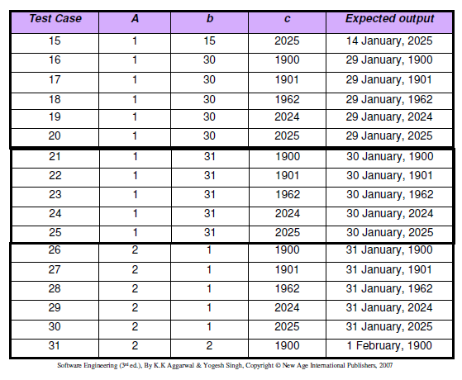

Slide 25
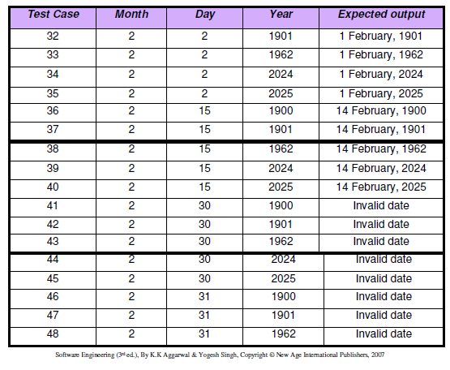

Slide 26
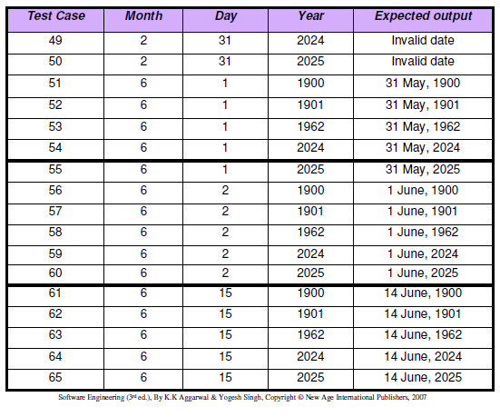

Slide 27
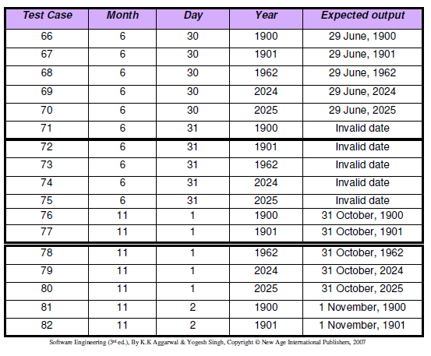

Slide 28
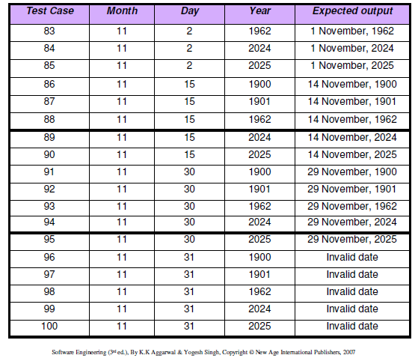

Slide 29
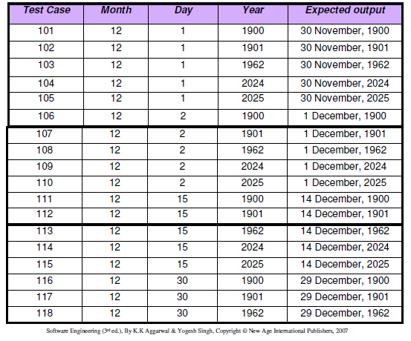

Slide 30
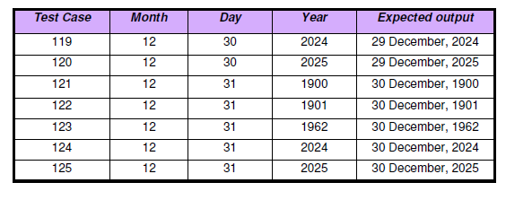

Slide 31
References
K.K. Aggarwal and Yogesh Singh, “Software Engineering”, Third Ed., New Age International (P) Limited Publishers. (2009).
Roger S. Pressman, “Software Engineering: A Practitioner’s Approach”, Fifth Ed., McGraw–Hill Higher Education, (2001).
Rajib Mall, “Fundamentals of Software Engineering”,Fourth Ed., PHI Learning Private Limited, (2016).
Pankaj Jalote, “An Integrated Approach to Software Engineering”, Third Ed., Narose Publishing House, (2008).

Slide 32
Thanks…

